Slide 1

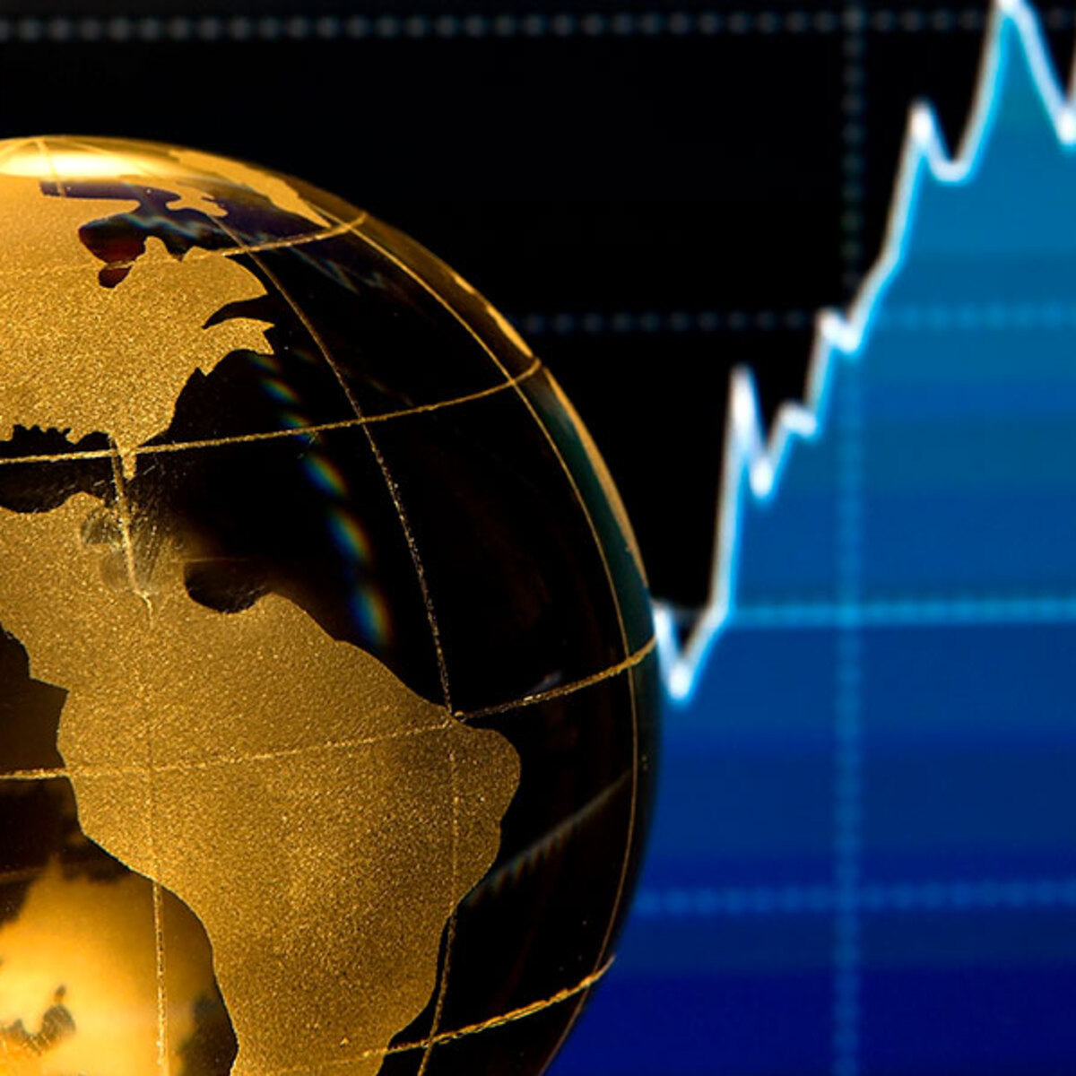
World Bank Development Indicators
Dataset Overview:
Global Metrics on
GDP, Inflation, Corruption, etc.
Project Goals:
Predict Economic Inequality
Classify Political Fragility
Cluster Countries Based on their Development Profiles
Link to Dataset: https://kaggle.com/datasets/nicolasgonzalezmunoz/world-bank-world-development-indicators/data
Teammates - Agnay Srivastava, Abdullah Islam

